Slide 1
LangChain Output Parsers
Structuring LLM Responses for Applications

Slide 2
What are Output Parsers?
Tools that convert raw LLM text output into structured formats
Enable integration of LLM responses with application code
Enforce specific response formats through instructions
Transform unstructured text into usable data structures

Slide 3
Why Use Output Parsers?
Consistency in LLM responses
Type validation and error handling
Easier integration with downstream systems
Improved developer experience
Standardized data extraction

Slide 4
PydanticOutputParser
Overview:
Uses Pydantic models to define structured output
Great for complex, nested data structures
Validates output against a schema
Ideal For:
Extracting structured information from biographical data
User profile generation
Complex entity extraction

Slide 5
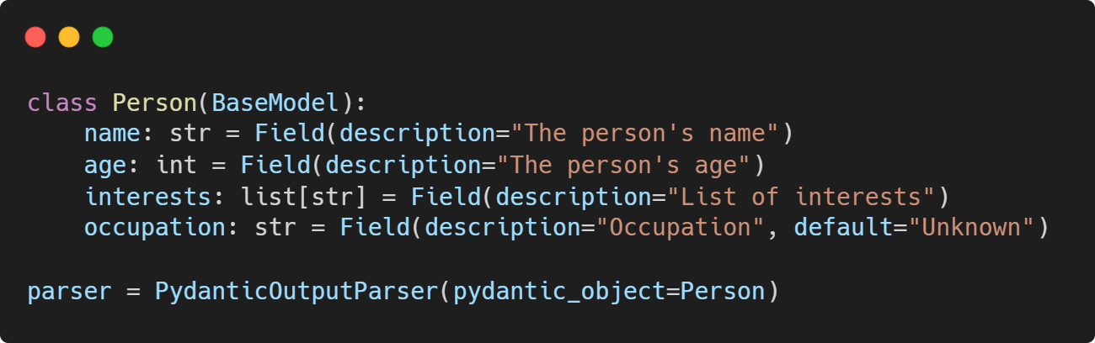
Example Use Case

Slide 6
CommaSeparatedListOutputParser
Query: What are a common list of fruits?
Output: [‘mangoes’, ‘apples’, ‘bananas]

Slide 7
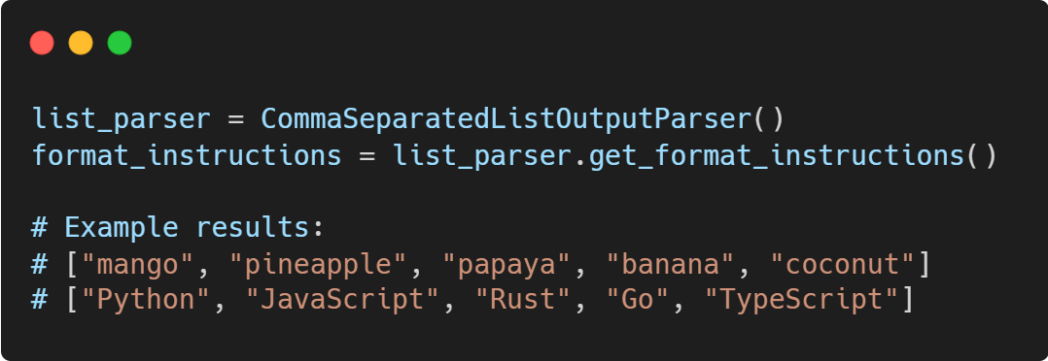
Example Use Case

Slide 8
StructuredOutputParser
Overview:
Defines custom response schemas
More flexible than Pydantic for simple cases
Allows for explicit field descriptions
Ideal For:
Simple attribute extraction
Sentiment analysis
Feature extraction from descriptions

Slide 9
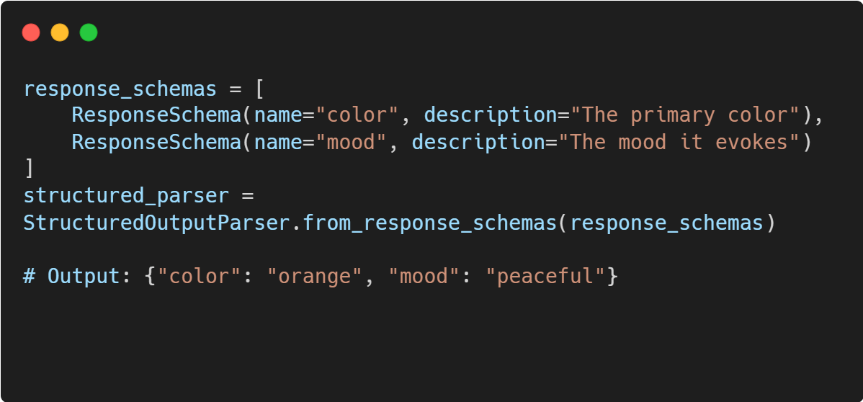
Example Use Case

Slide 10
Advanced StructuredOutputParser
Overview:
Handles multiple types of data
Supports mixed data types (strings, integers, lists, floats)
Provides more detailed schema control
Ideal For:
Product reviews
Media catalogs
Detailed assessment reports

Slide 11
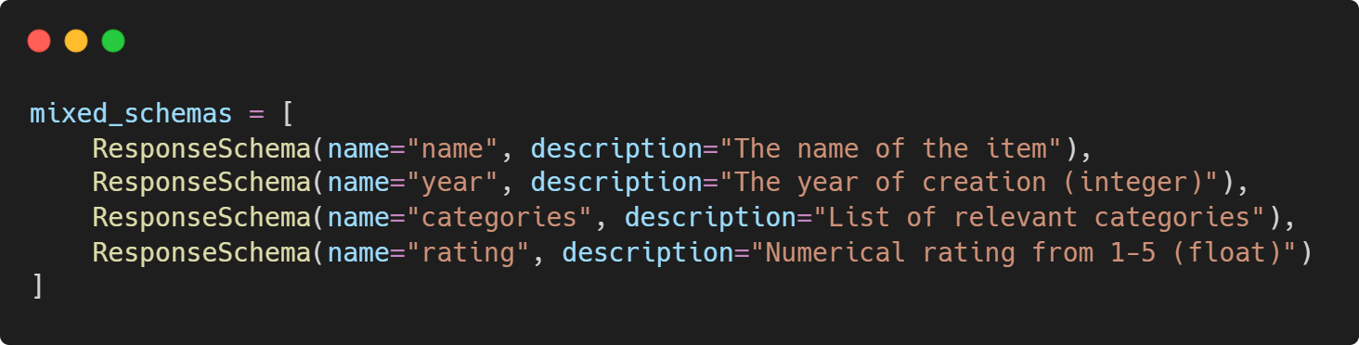
Example Use Case

